Slide 1
Research Communication Resources FROM YOUR LIBRARY
John Brosz, Libraries & Cultural Resources
Slides: brosz.ca/slides/storytellers

Slide 2
ROADMAP
Spaces
Guide
Share your story!
1
3
5
2
4
6
Equipment
People
Contact

Slide 3
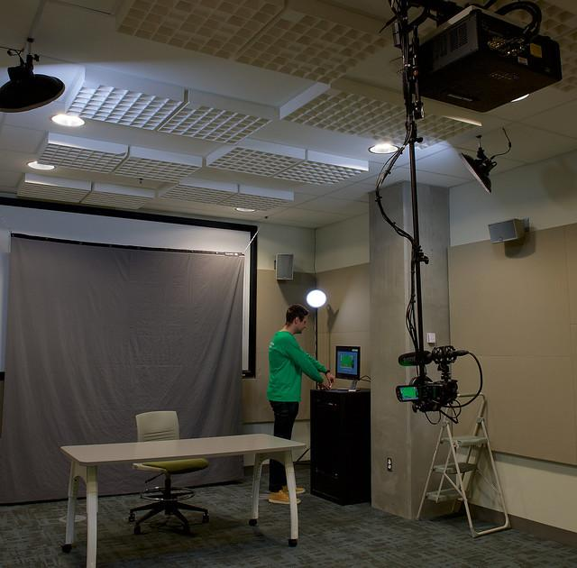
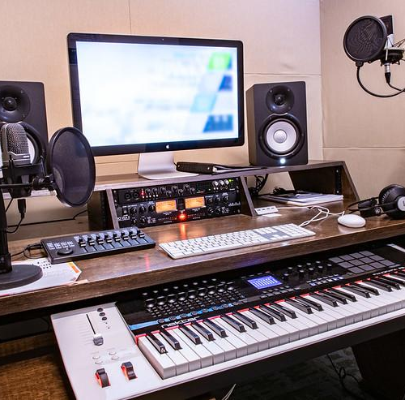
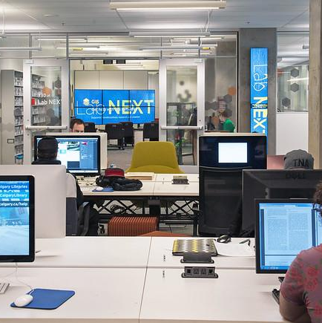
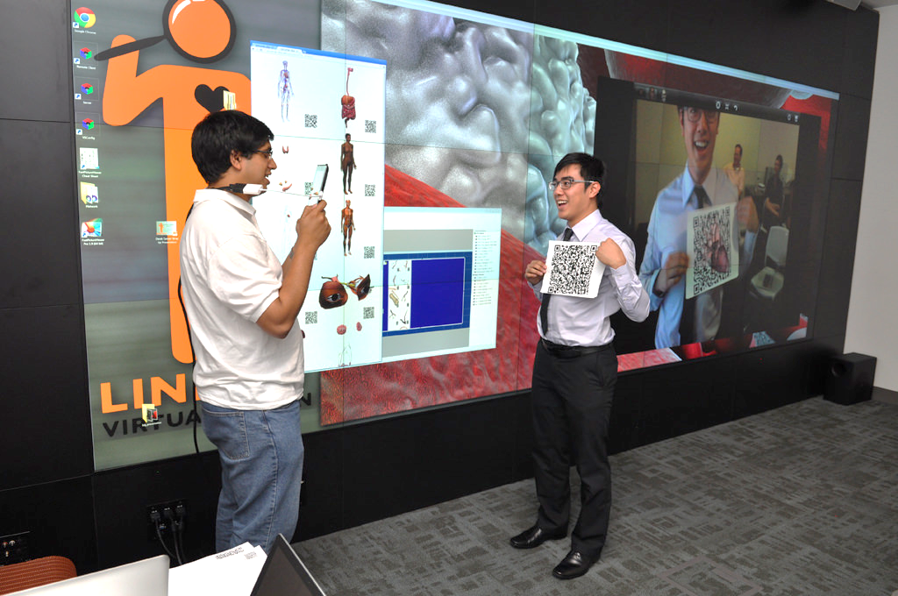
SPACES
One Button Studio
A/V Edit Suites
3rd Floor of the Taylor Family Digital Library
High Performance PCs & Digital Media Macs
Visualization Studio

Slide 4
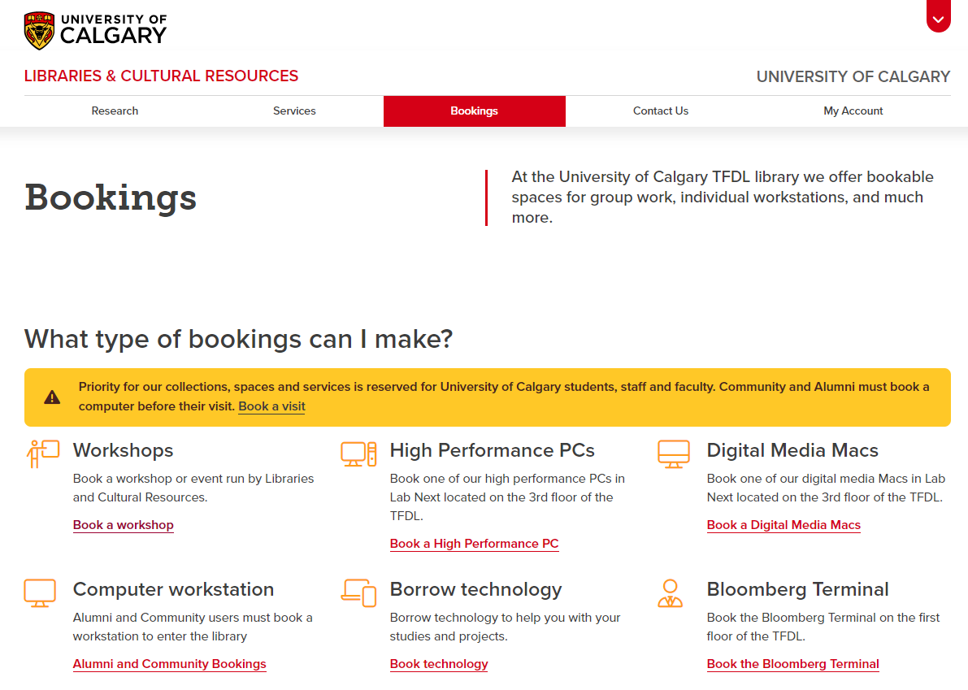
https://library.ucalgary.ca/services/bookings

Slide 5
EQUIPMENT
📷 DSLR cameras
🎥 Video cameras
🔊 Portable audio recorder
🎤 Microphones
✍ Drawing tablets
Notes:
Canon Vixix HFG20 camcorders, GOPRO Hero 4, Panasonic Camcorder HC-V770 Nikon D3300 (1 or 2 lenses)
Zoom Mobile Audio, Shure Mic,
Wacom Bamboo Create & Intuos Tablets

Slide 6
https://library.ucalgary.ca/services/bookings

Slide 7
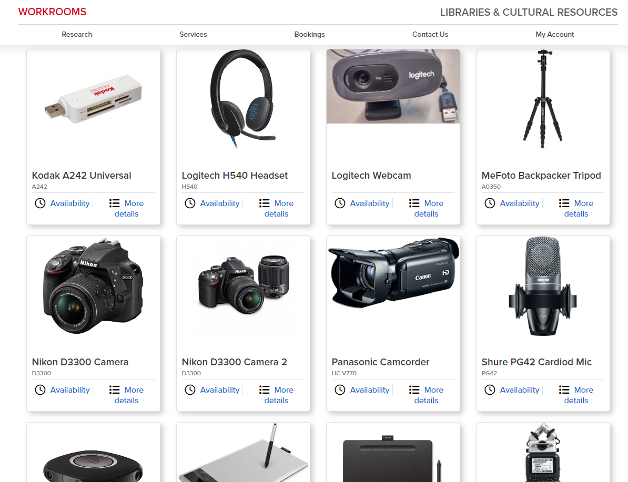
https://workrooms.ucalgary.ca/reserve/equipment/tfdl

Slide 8
MEDIA CREATION GUIDE
Tips & tricks
Filming
Audio & Podcasting
Music & Sound FX
Photography
Infographics
Links to royalty free media
Copyright & licensing
https://libguides.ucalgary.ca/guides/media-creation/home
Or search google for: ucalgary library media creation

Slide 9
Learning Resources Video Editing
Video Production by Liberated Learners:
https://ecampusontario.pressbooks.pub/learner/chapter/intro-to-video-production/
iMovie for Beginners by Teachers Tech: https://www.youtube.com/watch?v=gviqb7jOBZY
Widows 10 Video Editor by Kevin Stratvert: https://www.youtube.com/watch?v=t6yQwLuoO3w
Windows 11 Video Editing with Clipchamp by Kevin Stratvert:
https://www.youtube.com/watch?v=AMH38LNONoU
Adobe Premier Pro (2020) Basics Course: https://www.youtube.com/watch?v=MqwlW76sFCM
Compiled & vetted by Julia Guy
Handout at brosz.ca/slides/storytellers

Slide 10
Copyright & 3rd Party Material

Slide 11
Copyright & 3rd Party Material
Competition Rules:
The submission must be an entirely original work created by the applicant, and the applicant must have all necessary rights in and to the submission.
The submission must not infringe on or violate any laws or any third-party rights, including but not limited to copyright, patent, trademark, trade secret or other proprietary rights and must not constitute material that would be considered libeling, defamatory, a privacy violation, tortious or a contract breach.
The contestant must obtain, and make available to SSHRC, upon request, all necessary permissions, licenses, clearances, releases, waivers of moral rights and other approvals from third parties (including but not limited to all copyright holders and all individuals appearing in the submission) necessary to use the submission, in whole or in part, in any way. This includes, without limitation, permissions to reproduce, make derivatives, edit, modify, translate, distribute, transmit, publish and broadcast the submission worldwide, by any means.
https://www.sshrc-crsh.gc.ca/society-societe/storytellers-jai_une_histoire_a_raconter/challenge_regulations-defis_reglements-eng.aspx

Slide 12
Attribution
What is Attribution?
If you want to incorporate media, music, images, photos, or other creative works into a project, it is important to credit the creator of those works by providing attribution.
Attribution vs Citation
Attribution is different than citation. Citations serve an academic purpose and attributions serve a legal purpose. Attribution is required when you are incorporating someone else's creation into your own project.

Slide 13
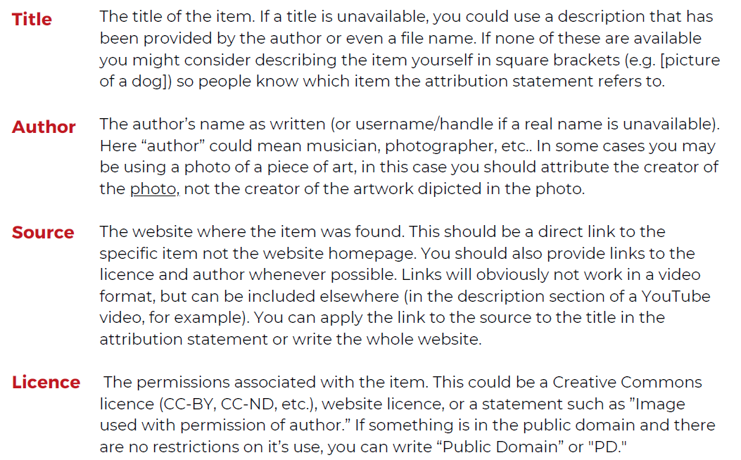
Attribution TASL method
Handout at brosz.ca/slides/storytellers

Slide 14
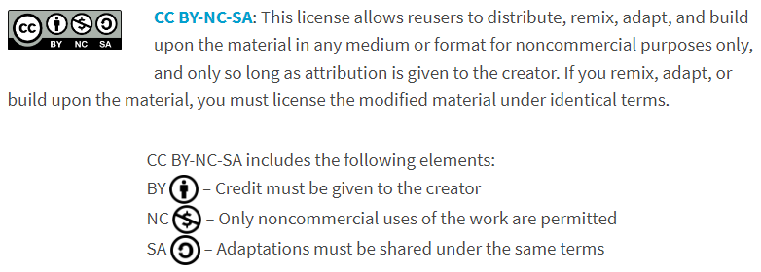
Creative Commons Licenses
From https://creativecommons.org/about/cclicenses/

Slide 15
3rd Party Media Images & Video
Pixabay (images or video) : https://pixabay.com/
Unsplash: https://unsplash.com/images
Pexels (images or video): https://www.pexels.com/
FreeImages:
https://www.freeimages.com/
Wikimedia Commons: https://commons.wikimedia.org/wiki
Handout at brosz.ca/slides/storytellers

Slide 16
3rd Party Media Images & Video
Free Music Archive: https://freemusicarchive.org/home
Ben Sound: https://www.bensound.com/free-music-for-videos
Freesound: https://freesound.org/
MUST BE ATTRIBUTED!
Handout at brosz.ca/slides/storytellers

Slide 17
Copyright Help
Copyright Office
copyright@ucalgary.ca
Answers questions & provide general guidance
Handout at brosz.ca/slides/storytellers

Slide 18
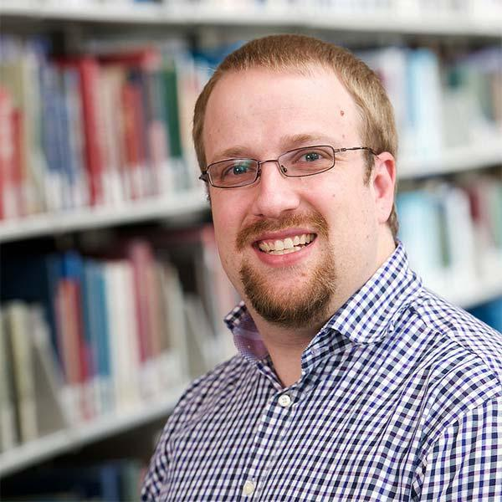
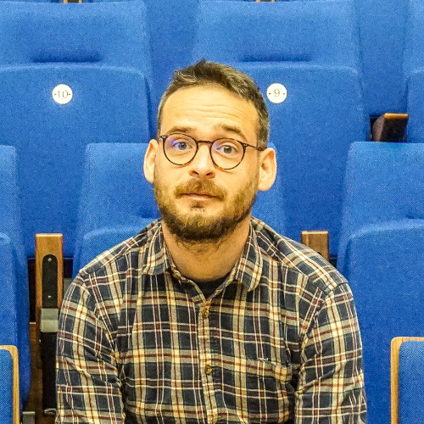
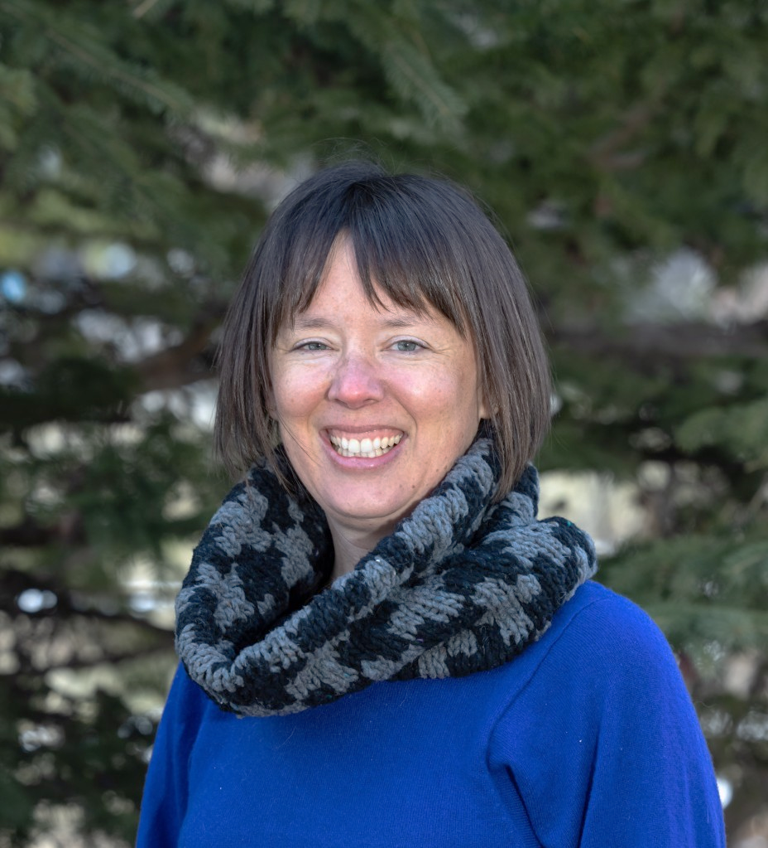
PEOPLE
labnext@ucalgary.ca
John Brosz Data Visualization Curator
jdlbrosz@ucalgary.ca
Marc Stoeckle Librarian - Arts & Audio mstoeckle@ucalgary.ca
Christie Hurrell
Director of Lab NEXT
achurrell@ucalgary.ca

Slide 19
PRESERVE AND SHARE YOUR RESEARCH STORY!
After the competition, consider uploading your story to PRISM:
Permanent, stable, public
Discoverable & citable
DOI
Viewing Stats
prism.ucalgary.ca
Notes:
After the competition is over, consider sharing your submission publicly!

Slide 20
Slides: brosz.ca/slides/storytellers
Equipment bookings
https://library.ucalgary.ca/services/bookings
Library media guide
https://libguides.ucalgary.ca/guides/ media-creation/home
Handouts
brosz.ca/slides/storytellers
Media creation & attribution
Any questions?
You can find me at JDLBrosz@UCalgary.CA
Slides: brosz.ca/slides/storytellers

Slide 21
CREDITS
Slides: brosz.ca/slides/storytellers
Special thanks to all the people who made and released these awesome resources for free:
Presentation template by SlidesCarnival
Photographs by Unsplash

